Slide 1
Designing Infographics

Slide 2
Getting Started
An infographic pairs solid reporting with attractive, purposeful design in print and on the web. Done well, an infographic can convey important information in a simple form or break down complex material for readers.
Today we’ll look at infographic types in the context of design. Remember that the infographic is dependent on reliable data.

Slide 3
Benefits
Infographics break information into smaller parts, making it easier to understand and more likely to be remembered.
They create additional entry points, breaking up text-heavy pages in print or a long, narrow story on the web.

Slide 4
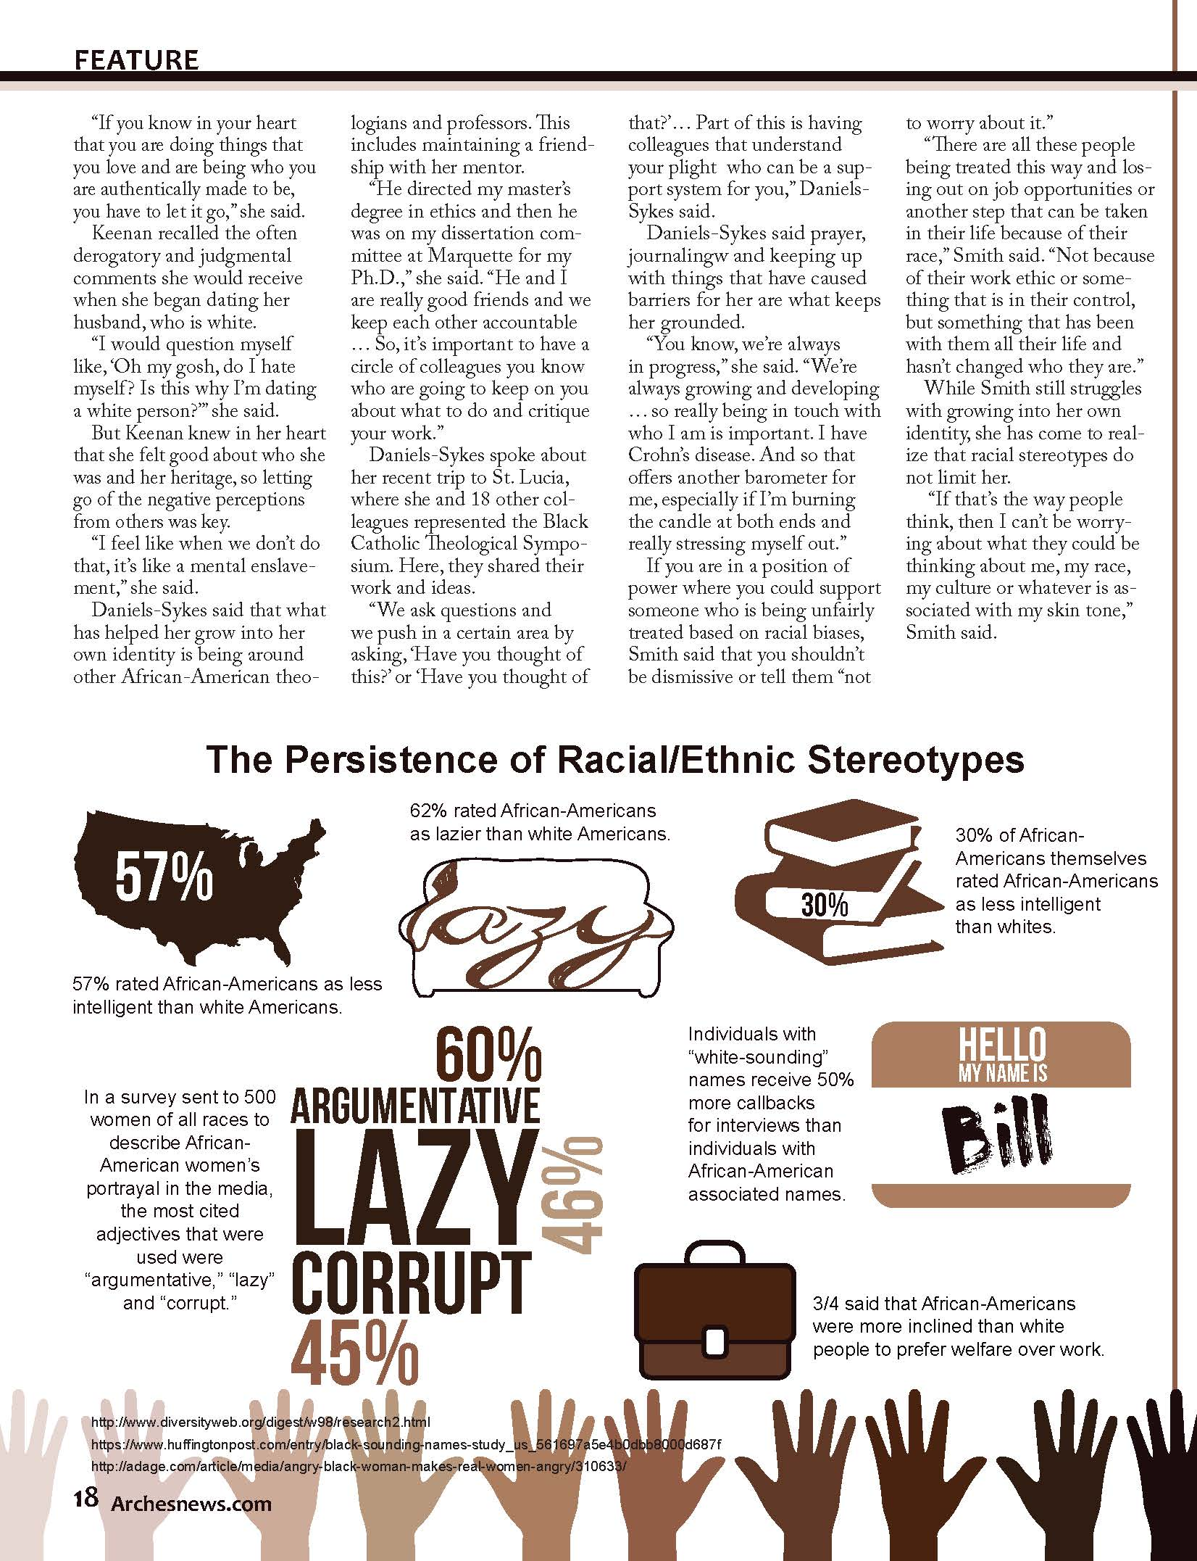
Mount Mary University, reMARK 2017

Slide 5
By Definition
An infographic combines text and illustrations to convey information visually. An infographic generally has four parts:
headline (a title to indicate topic/subject)
data (the “info” part: numbers, statistics, terms or key content to deliver)
visual (icon, photo, illustration or art element: the “graphic” aspect)
source (credible origin of information)

Slide 6
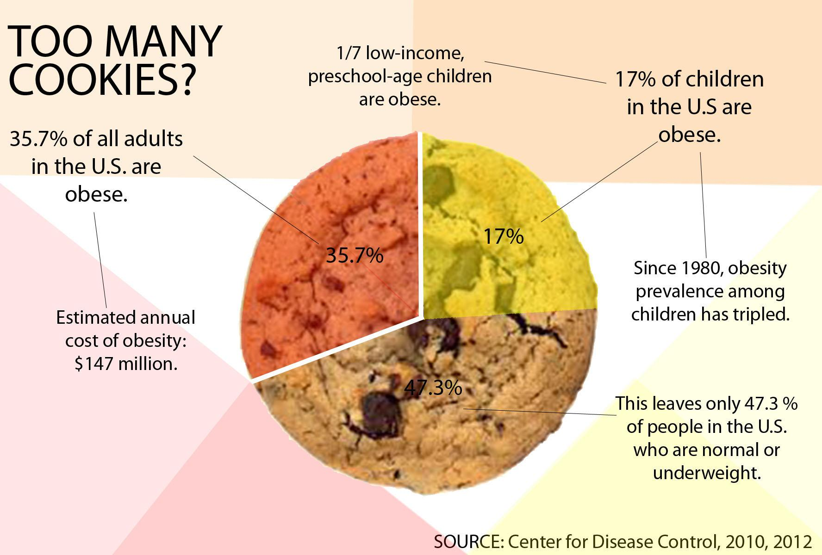
Pie Chart
Whitney High Student Media, Rocklin, Calif.

Slide 7
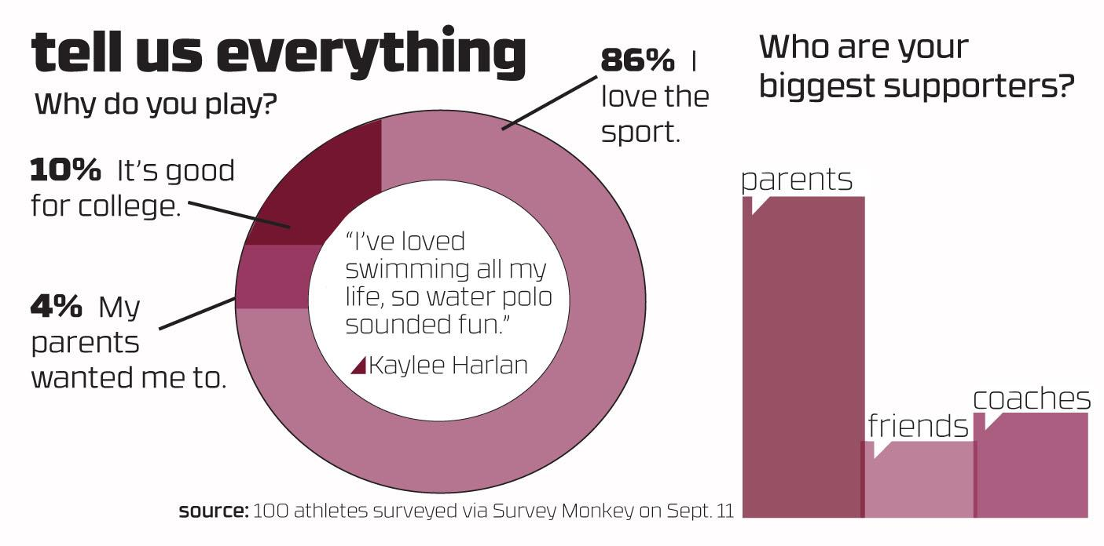
Public Opinion Poll
Whitney High Student Media, Rocklin, Calif.

Slide 8
Step by Step
lists the steps used to demonstrate a process or to simplify something compicated by breaking I down into parts

Slide 9
Timeline
presents key events in the order they occurred. It can be marked by years, days, hours or even minutes.
Arches, Mount Mary College, Feb/Mar 2014

Slide 10
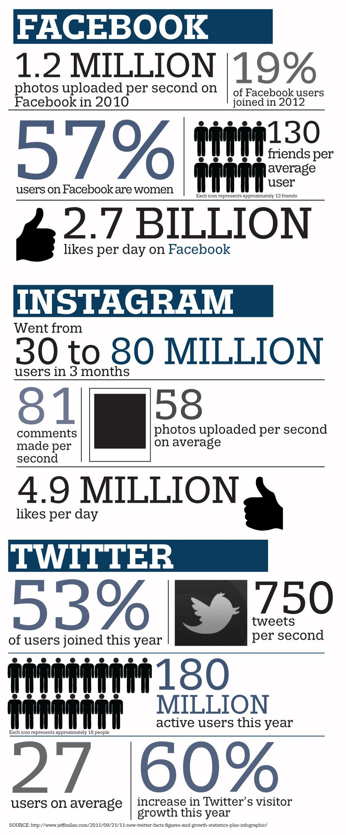
Fast Fact Box
delivers information
in bite-size “chunks”
based on facts or statistics
Whitney High Student Media, Rocklin, Calif.

Slide 11
Bar Graph
conveys visual representation of statistics related to the story
Arches, Mount Mary College (Feb/March 2014)

Slide 12
Glossary
lists key terms with their definition.
It delivers information
in bite-size “chunks”
reMARK, Mount Mary University, 2016

Slide 13
Diagram
labels parts of a whole or breaks down something complex into smaller pieces
Arches, Mount Mary University, 2016

Slide 14
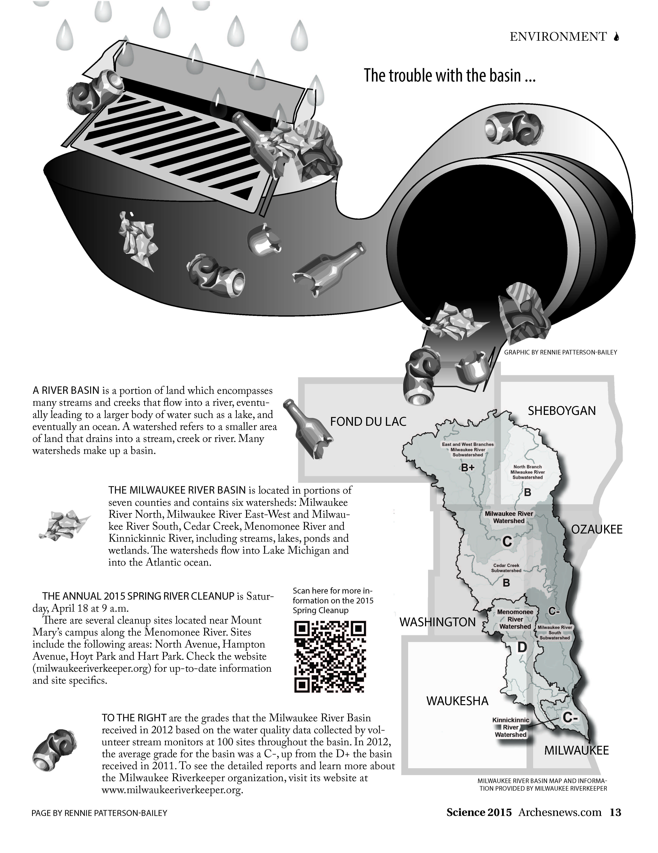
Diagram
labels parts of a whole or breaks down something complex into smaller pieces
Arches, Mount Mary University, 2015

Slide 15
Map
Mount Mary University, Arches, Fall 2017

Slide 16
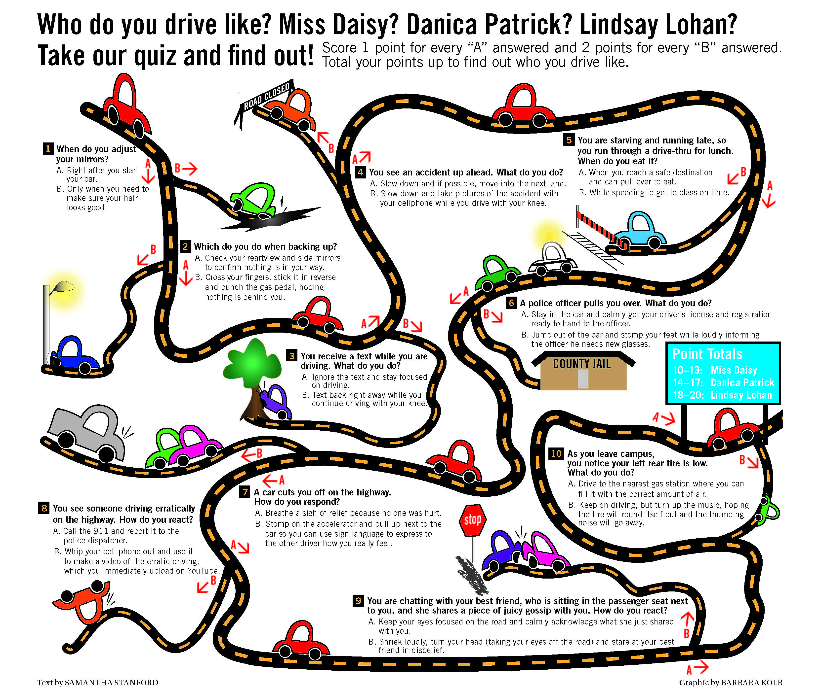
Quiz
is questions for the reader, usually used to convert data or factual information in a teaching way
Mount Mary College, Arches, Fall 2013

Slide 17
Two Main types
Infographics generally fall into these two types:
supplemental
an infographic that accompanies a traditional story; usually placed beside it on a page to provide additional information or to break down complex ideas from the copy block
standalone
an infographic presented by itself as the story; readers should be able to take away complete information (infographic provides full context)

Slide 18
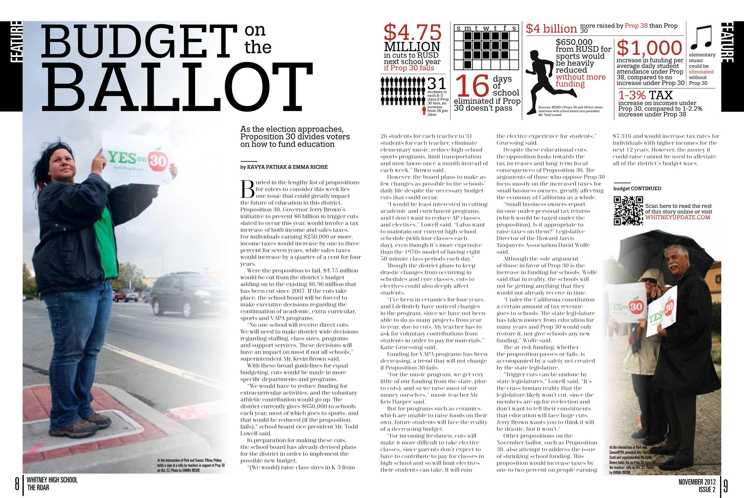
Whitney High Student Media, Rocklin, Calif.

Slide 19
Supplemental
this infographic accompanies the main story
(see previous slide)

Slide 20
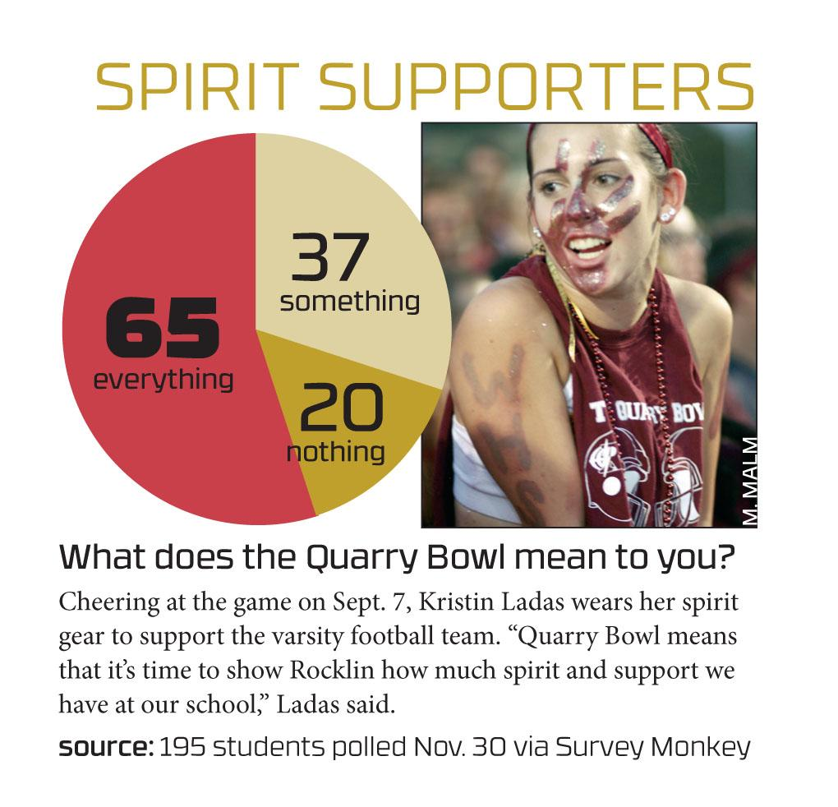
Standalone
Whitney High Student Media, Rocklin, Calif.

Slide 21
Design Decisions
coordinate color
follow visual hierarchy
focus on readability
Whitney High Student Media, Rocklin, Calif.

Slide 22
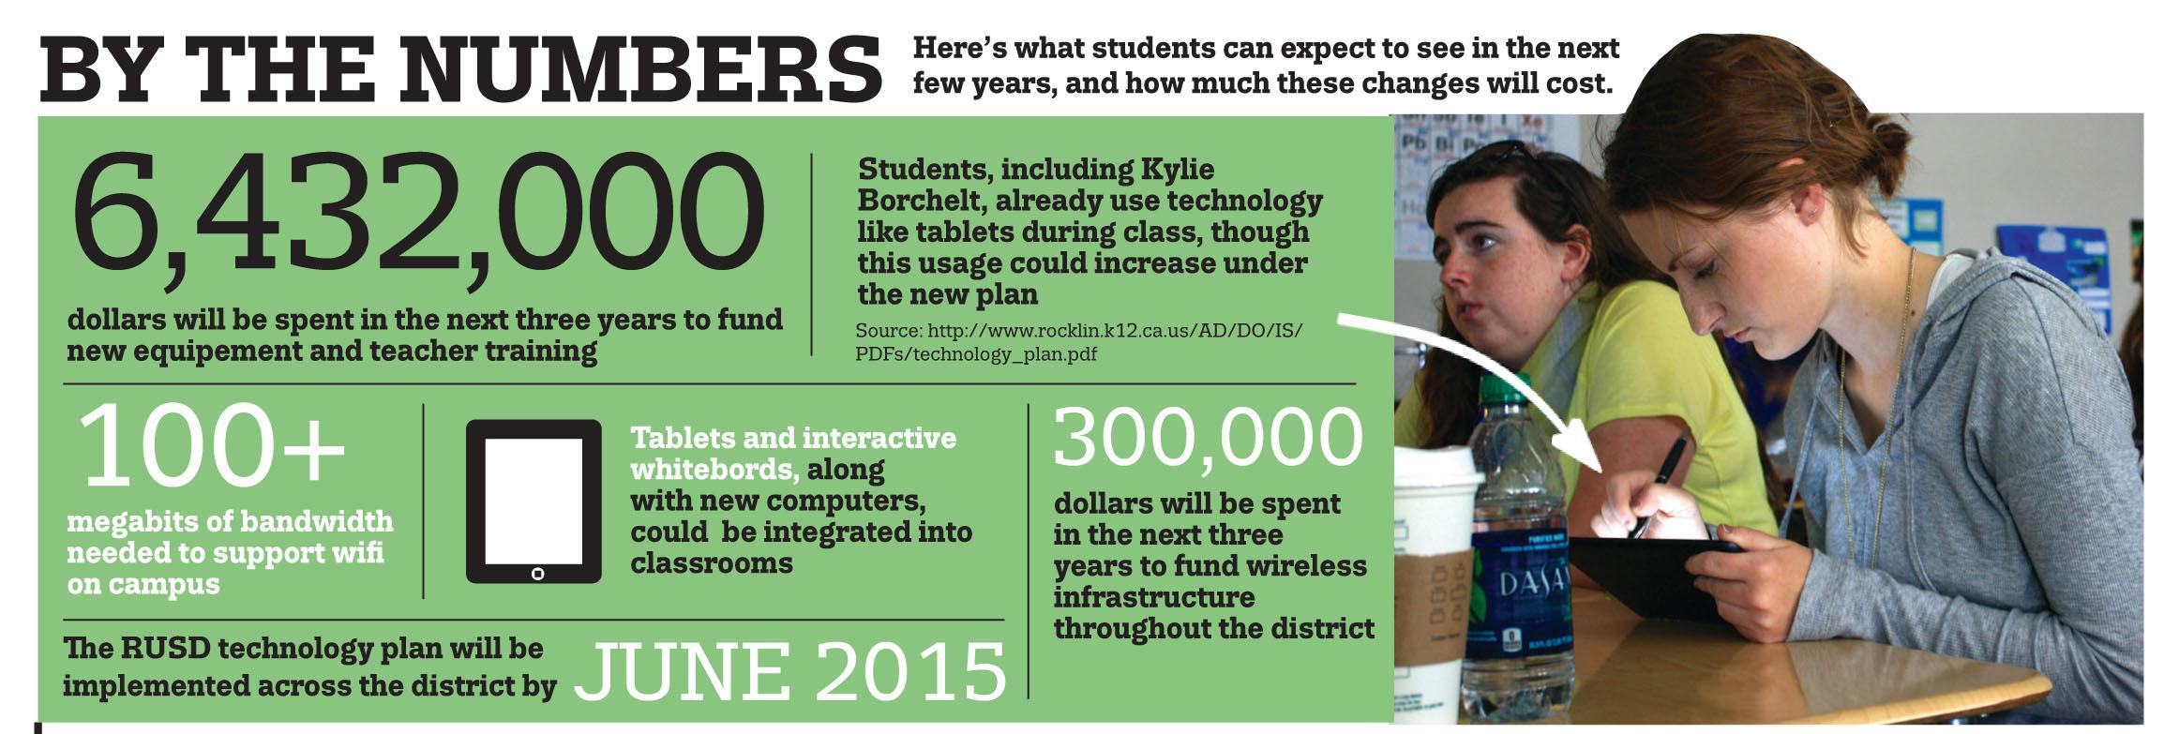
Keep Type Simple, Consistent
Whitney High Student Media, Rocklin, Calif.

Slide 23
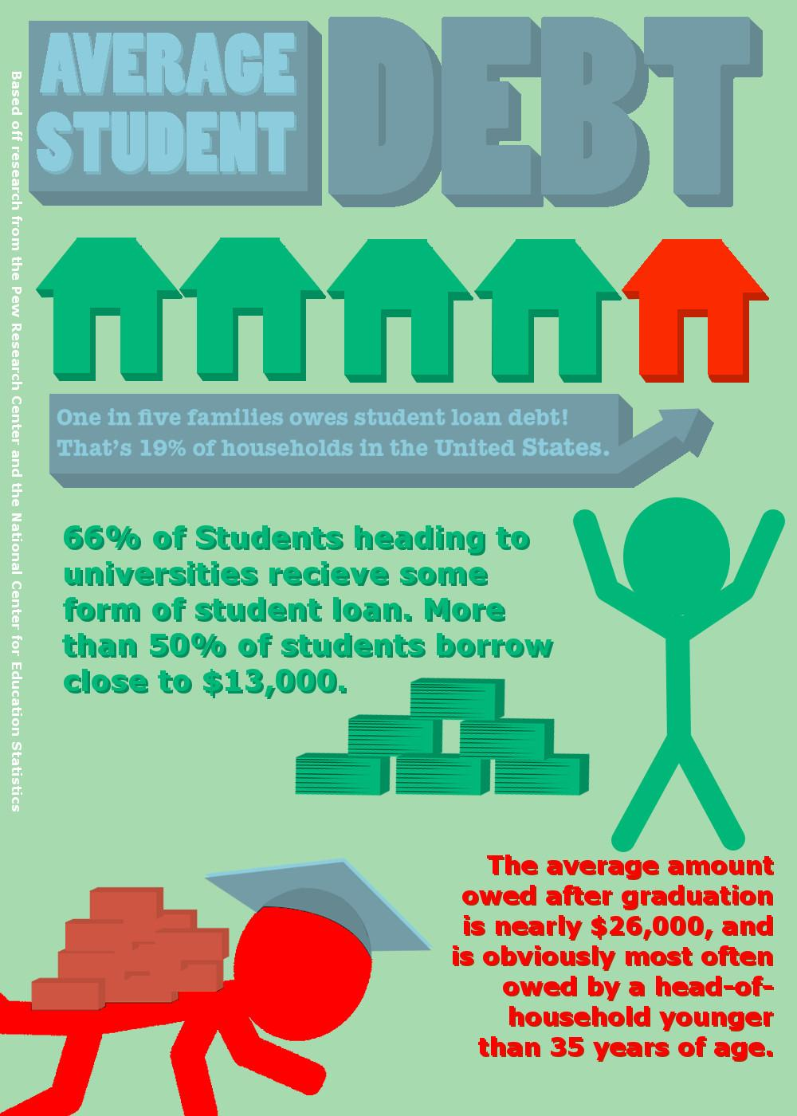
small text in color is difficult to read
pay attention to alignment, case, hyphenation and other type considerations
as with all design decisions, remember: “form follows function”
Readability
Whitney High Student Media, Rocklin, Calif.

Slide 24
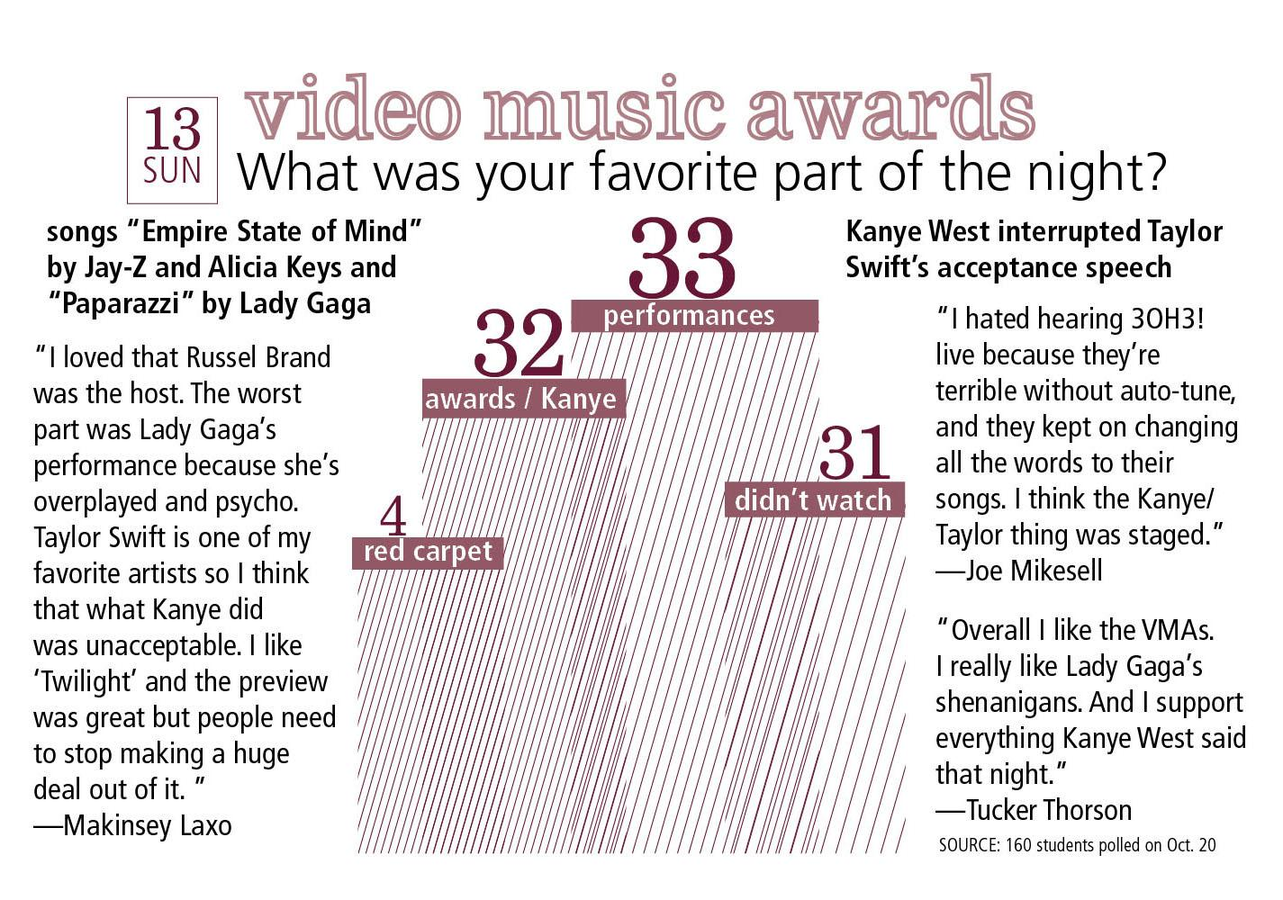
graphic element such as lines (diagonal lines, outline date box, type outline in headline
repeating color use
Design Unity
Whitney High Student Media, Rocklin, Calif.

Slide 25
shapes from rounded graphic to circle photos use of tints to create visual variety on black-and-white page
Design Unity
The Echo; St. Louis Park (Minn.) High School

Slide 26
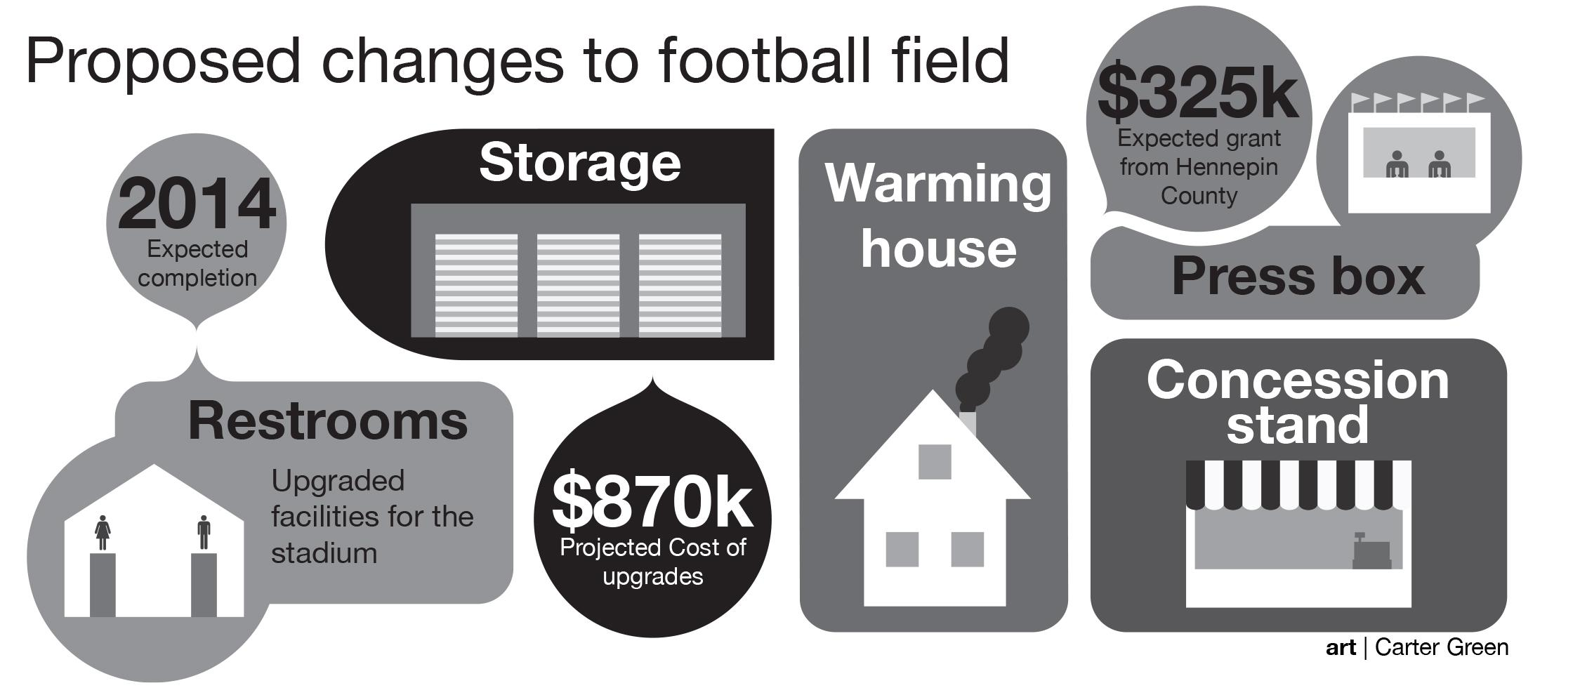
Tight Space (packaging proximity)
The Echo; St. Louis Park (Minn.) High School

Slide 27
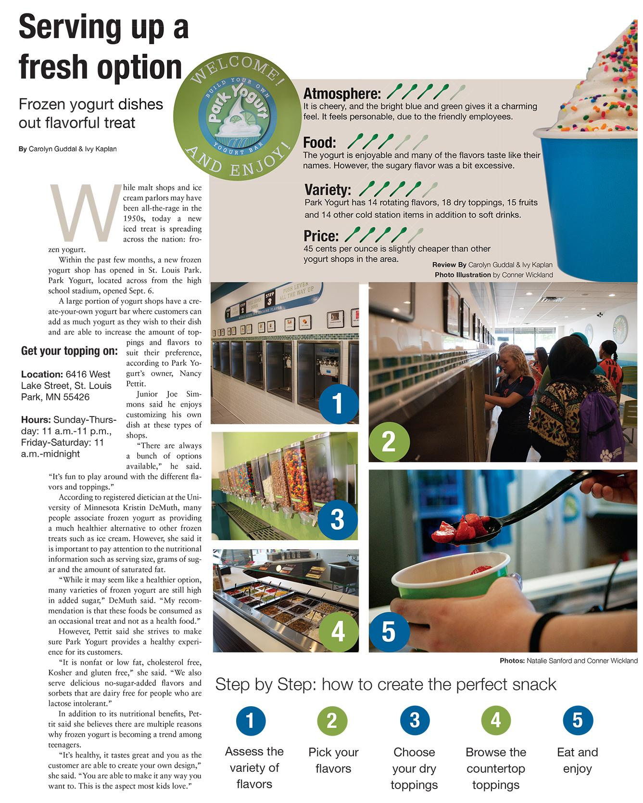
Combination
This supplemental infographic combines ratings with a step-by-step guide
The Echo; St. Louis Park (Minn.) High School

